Slide 1
COVID-19:
Exploratory Data Analysis
Authors:
Alissa Stover
Alyssa Augsburger
John Lee
Nathan Nusaputra
Ryan Sawasaki
Spring Break 2020
Github Repository: https://github.com/CSJohnLee/COVID19_Project

Slide 2
Introduction
Background:
Classmates of “ Python Fundamentals for Data Science” collaborated to conduct an exploratory data analysis (EDA) on COVID-19 data. What they found was not contrary to popular beliefs and validates expectations.
Objective:
Better understand and visualize COVID-19 data.
Our Curiosities:
How do different states compare?
How does population and income affect number of cases?

Slide 3
Data-Sourcing & Processing
Problem:
COVID-19 data is coming in in real-time, from multiple sources, and with different data management practices. Sifting through this information is time-consuming and can be a barrier to data use.
Solution:
We compared the data quality of 3 sources and documented our findings so that other researchers could more easily choose which data to use for their own explorations. The code we used to source and process the data is documented on our Github, so that other researchers can use our code to download the most recent data themselves.
The datasets were not large, so we were able to process them using Python in a Jupyter Notebook, by connecting to their respective website using using HTTP requests.
To assess data quality, we focused on:
which information was contained in each dataset
what level the data are on
how complete the data were
whether the data could be joined to other sources

Slide 4
Data Quality Assessment
New York Times COVID-19 Github repository: https://github.com/nytimes/covid-19-data
While this dataset was utilized for a few analyses, we recommend not using this source in the future, as the sources below seemed to have a more ideal format
Advantages:
Already in long format, at the state and county level
Contains information about time, place, and COVID cases/deaths
Disadvantages:
Mix of county versus city level data, so many FIPS codes are missing
The way data are updated makes it unclear why there are discrepancies in cases/deaths for each date for a given location, and thus which count should be used
USA Facts: https://usafacts.org/visualizations/coronavirus-covid-19-spread-map/
We recommend using this source for county-level COVID analyses
Advantages:
County-level COVID cases, deaths, and overall population data are well documented with clean FIPS codes. These can be merged together and on other data sources.
Disadvantages:
In wide format with columns for every date, which means that it must be transformed to long format for most analyses
COVID Tracking Project: https://covidtracking.com/data
We recommend using this source for state-level COVID analyses
Advantages:
Very detailed COVID data, including information about what treatments people are getting (e.g., how many people are in ICU)
Clean FIPS codes can be merged on other data.
Disadvantages:
Only at the state level

Slide 5
Introductory Plots

Slide 6
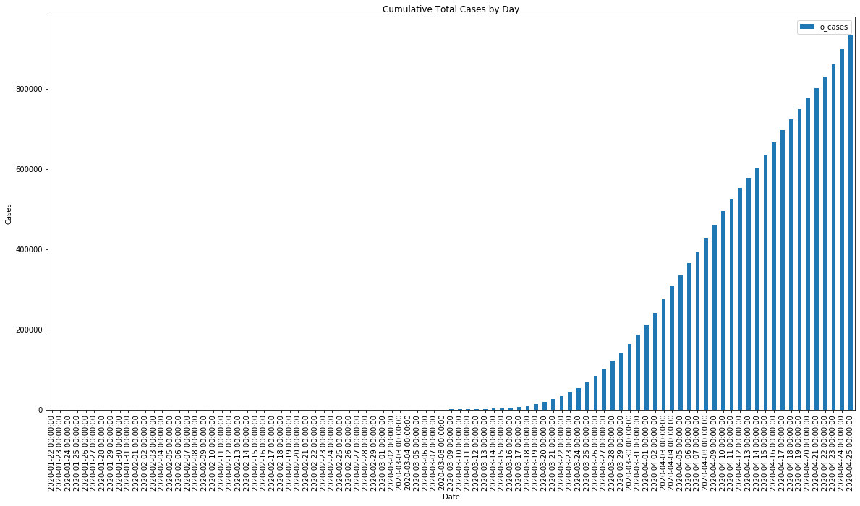
Cumulative Cases by Day
Data Source: https://usafacts.org/visualizations/coronavirus-covid-19-spread-map/

Slide 7
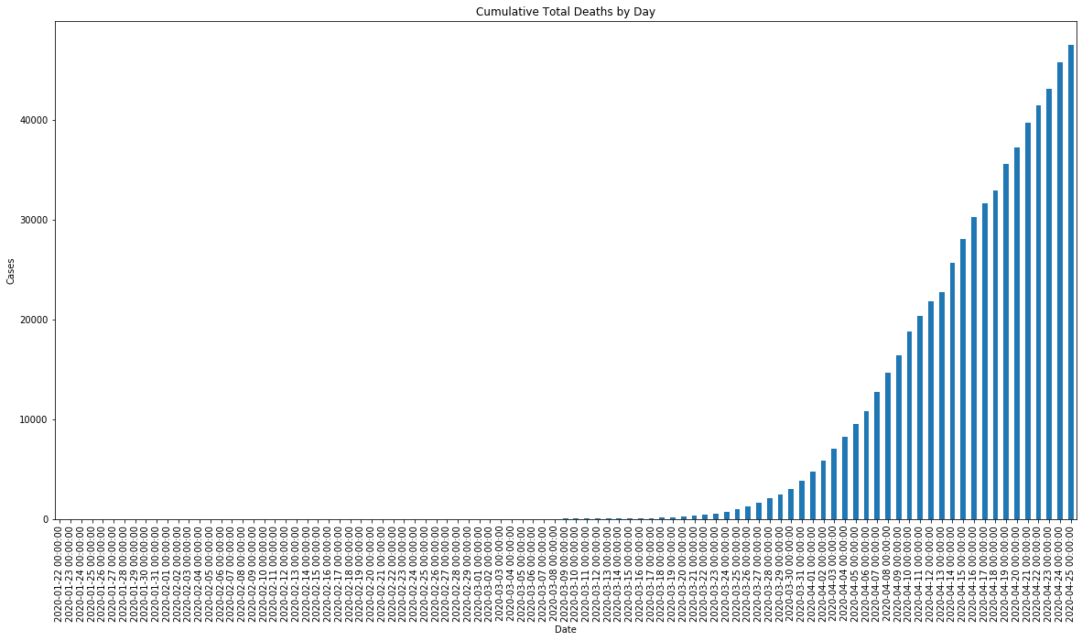
Cumulative Deaths by Day
Data Source: https://usafacts.org/visualizations/coronavirus-covid-19-spread-map/

Slide 8
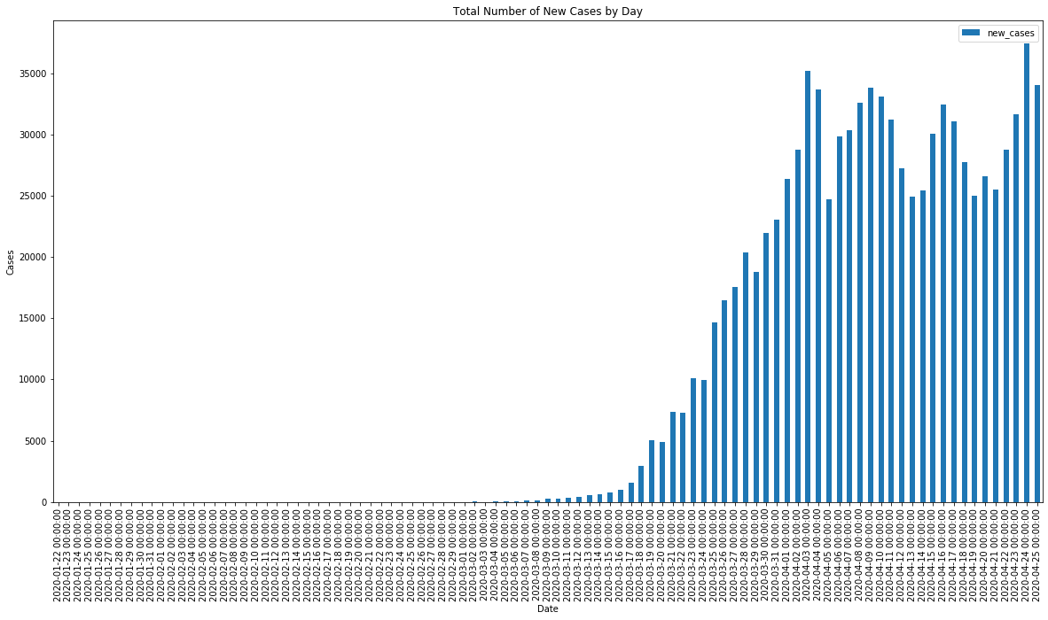
New Cases by Day
Data Source: https://usafacts.org/visualizations/coronavirus-covid-19-spread-map/

Slide 9
How do different states compare?

Slide 10
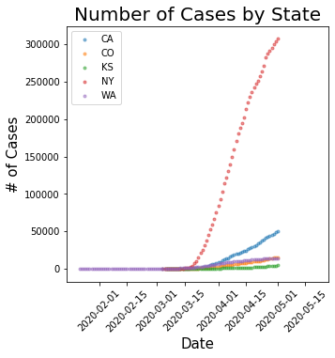
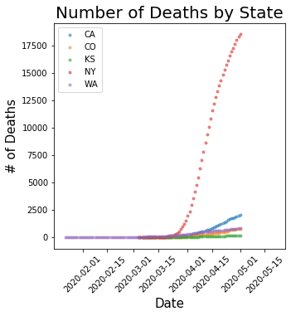
Out of our home states, New York is doing worse.
Data Source: https://covidtracking.com/data

Slide 11
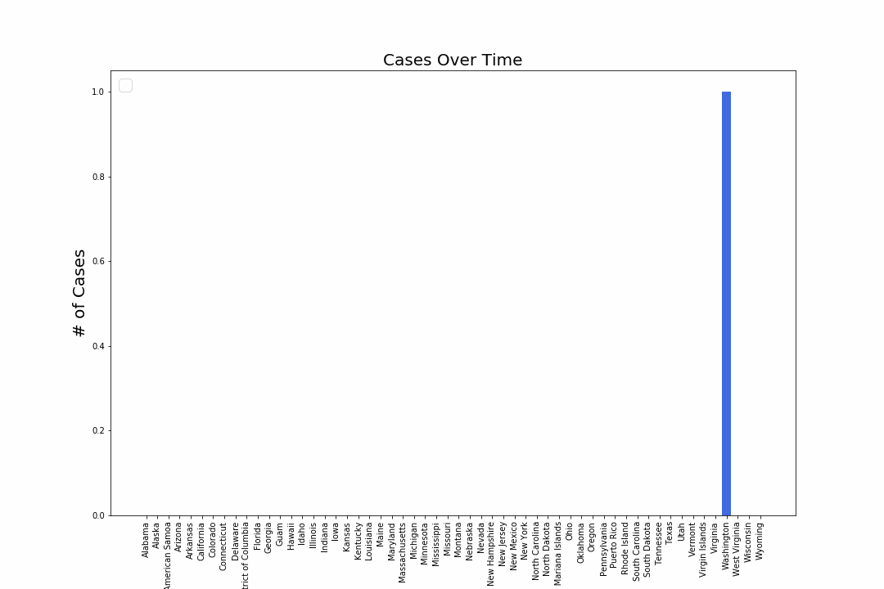
Cases Over Time. Reported cases increase late February.
Data Source: https://covidtracking.com/data

Slide 12
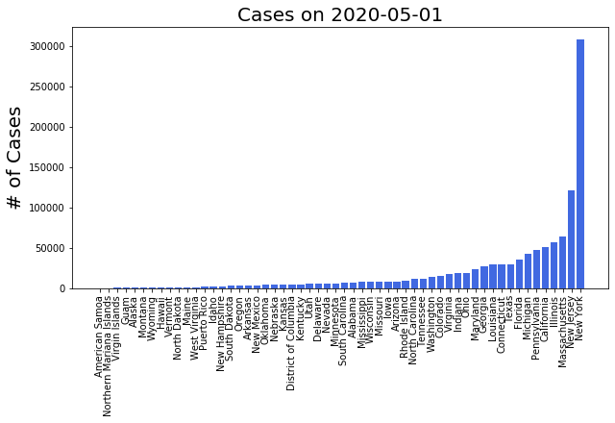
Cases per State (as of 5/1/2020)
Data Source: https://covidtracking.com/data

Slide 13
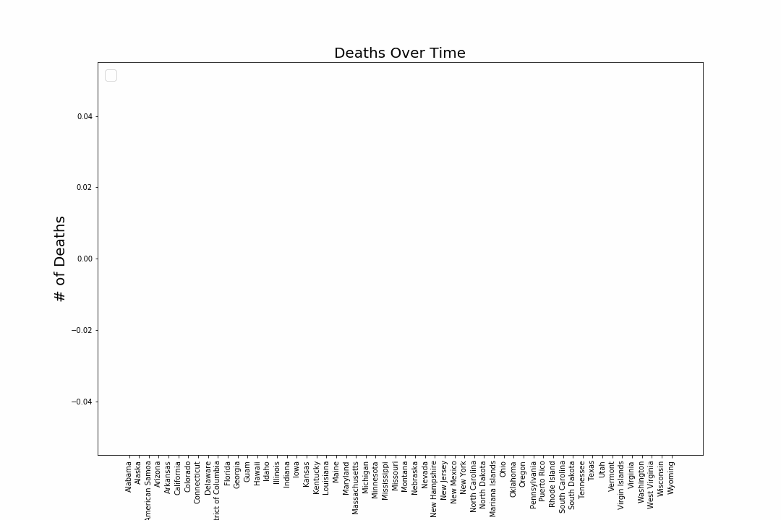
Deaths Over Time. Reported deaths begin late February.
Data Source: https://covidtracking.com/data

Slide 14
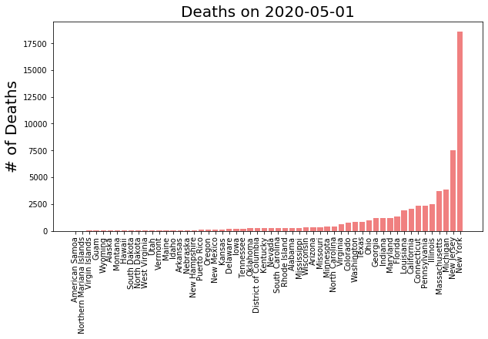
Deaths per State (as of 5/1/2020)
Data Source: https://covidtracking.com/data

Slide 15
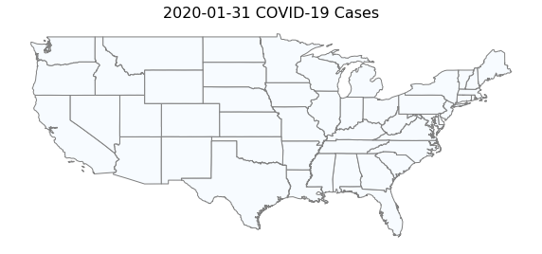
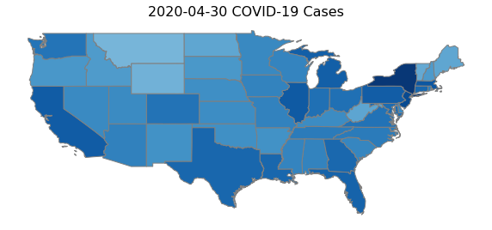
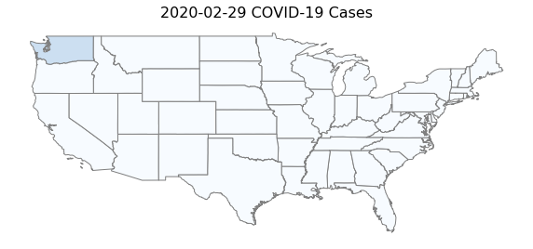
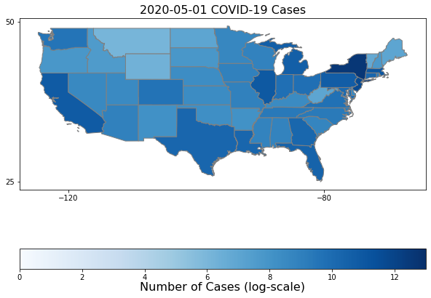
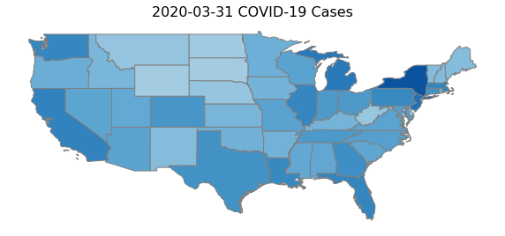
How are cases spreading?
Data Source: https://covidtracking.com/data

Slide 16
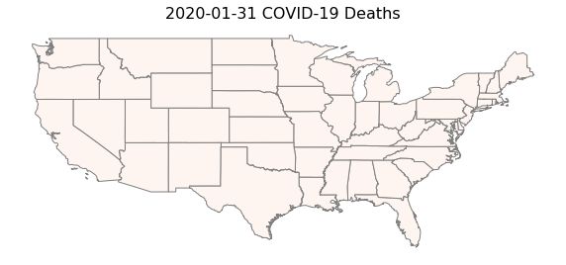
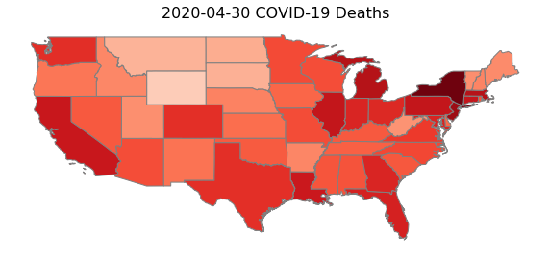
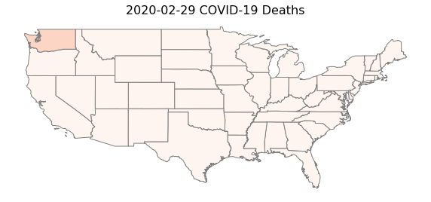
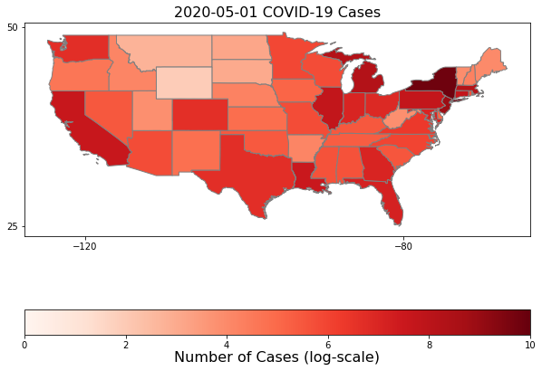
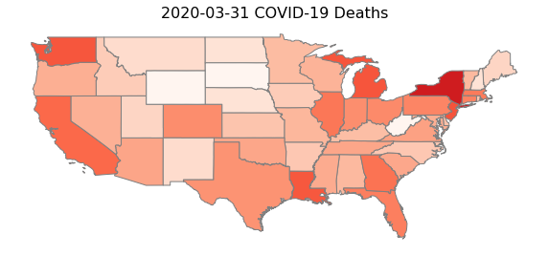
How are deaths spreading?
Data Source: https://covidtracking.com/data

Slide 17
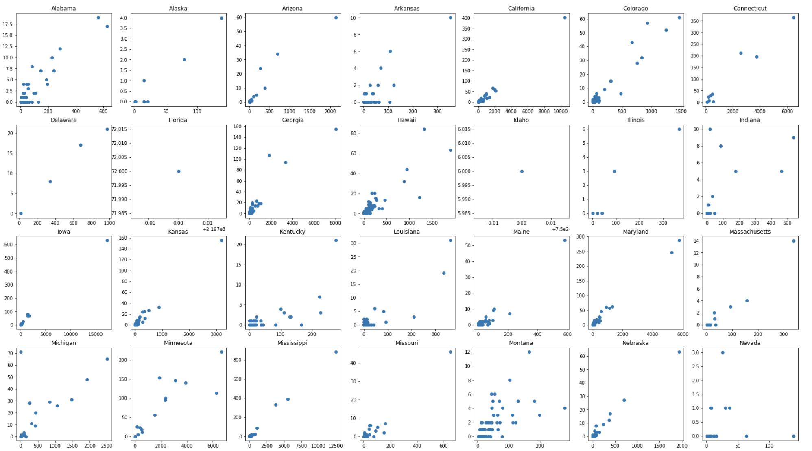
Cases vs. Deaths Part 1
Data Source: https://github.com/nytimes/covid-19-data

Slide 18
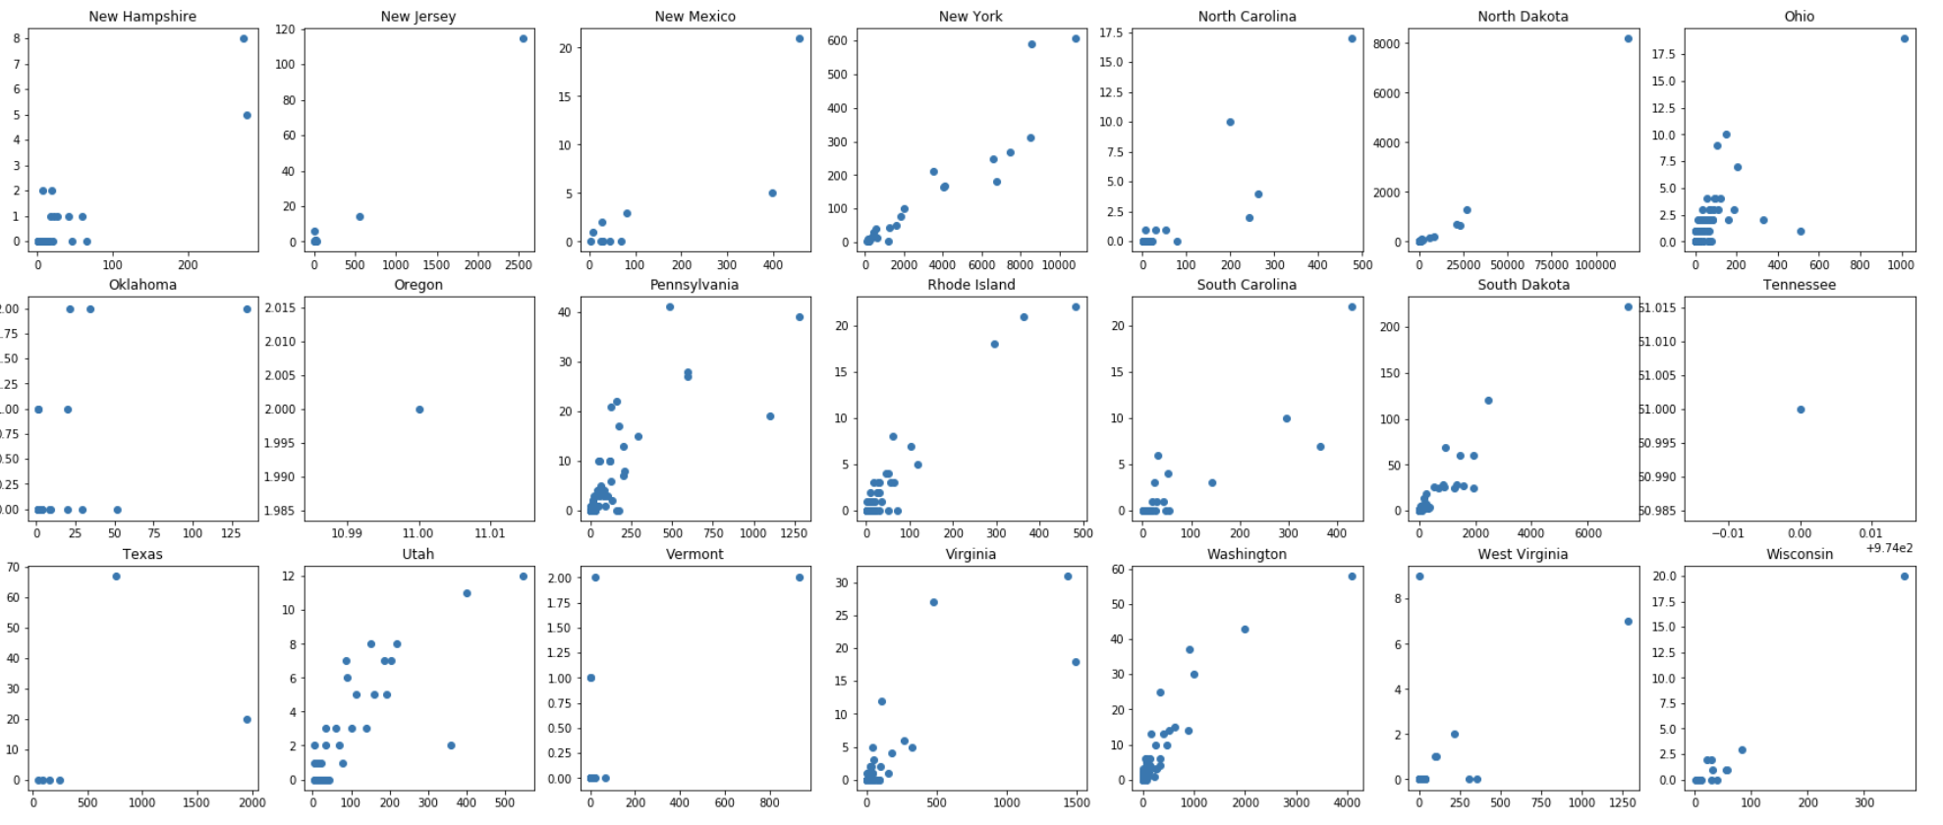
Cases vs. Deaths Part 2
Data Source: https://github.com/nytimes/covid-19-data

Slide 19
How does population affect number of cases?

Slide 20
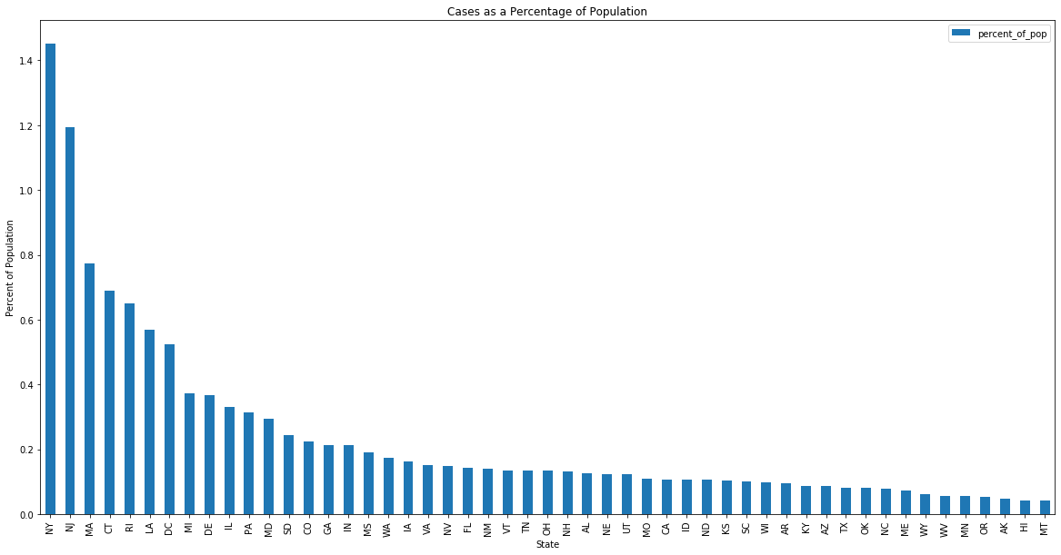
Cases as a Percentage of Population
Data Source: https://usafacts.org/visualizations/coronavirus-covid-19-spread-map/

Slide 21
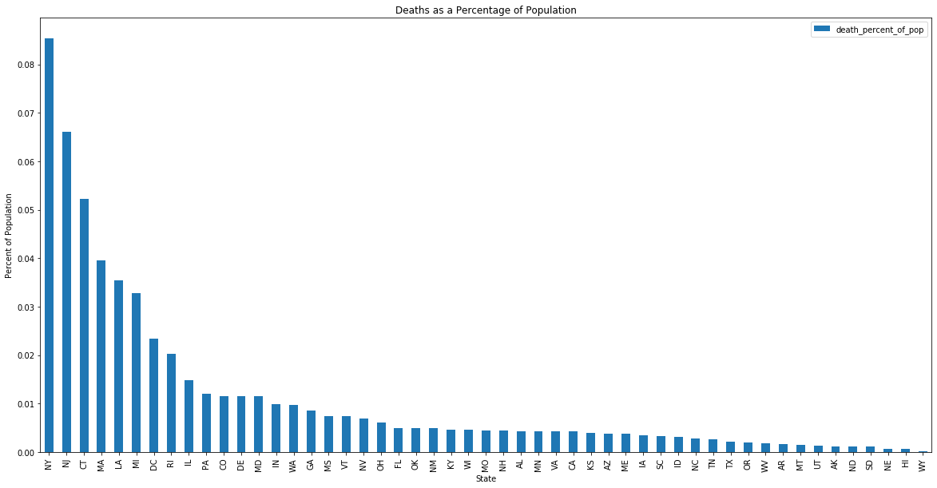
Deaths as a Percentage of Population
Data Source: https://usafacts.org/visualizations/coronavirus-covid-19-spread-map/

Slide 22
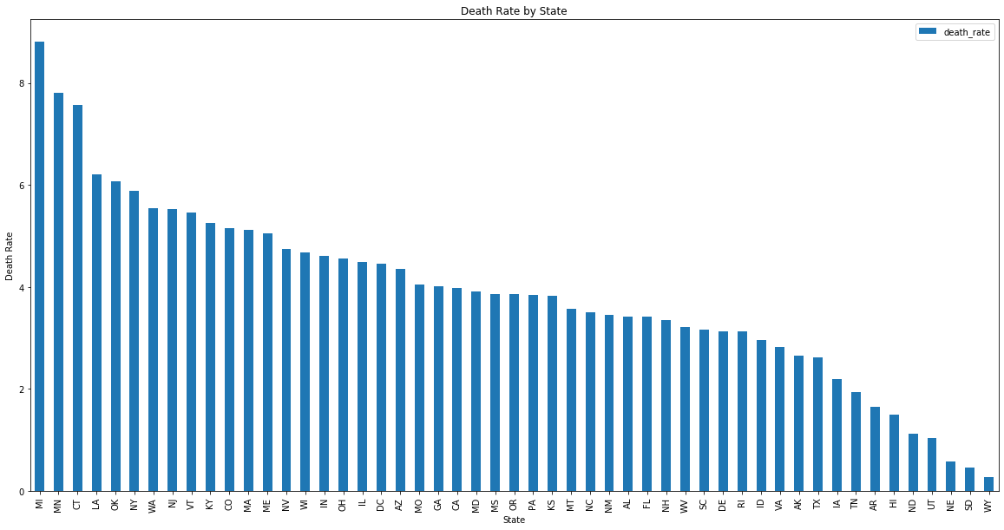
Death Rate (deaths per case) by State
Data Source: https://usafacts.org/visualizations/coronavirus-covid-19-spread-map/

Slide 23
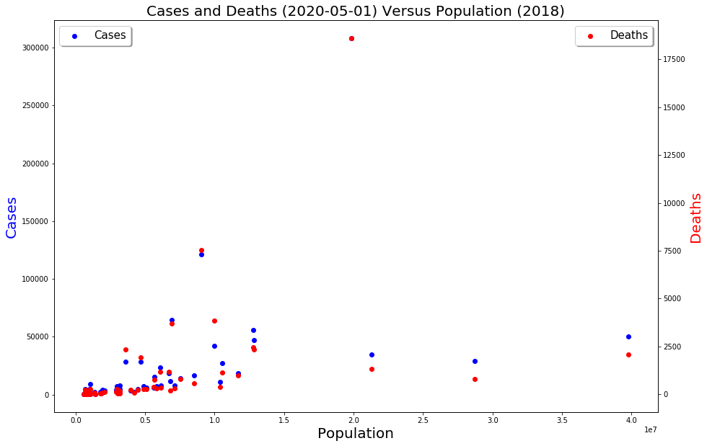
Cases & Deaths Versus State Populations
Data Source: https://covidtracking.com/data https://www.kaggle.com/lucasvictor/us-state-populations-2018#State%20Populations.csv

Slide 24
How does income affect number of cases?

Slide 25
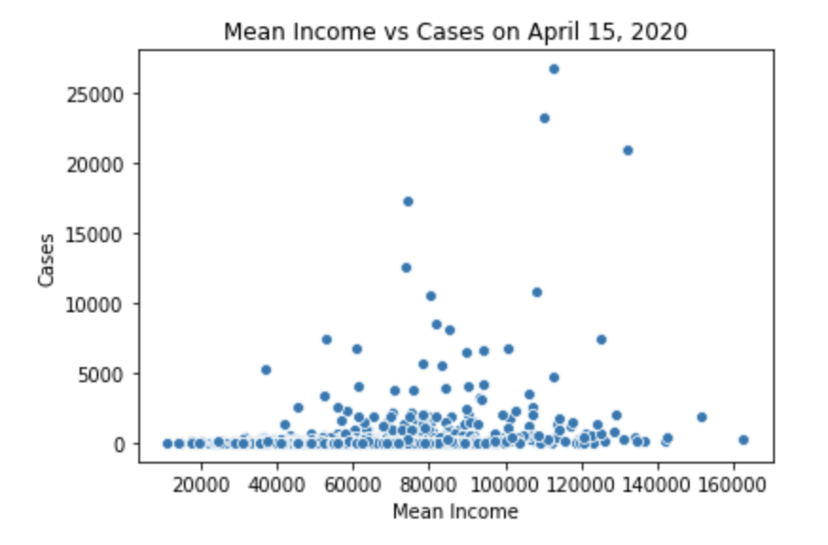
Effect on Wealth
Data Source: https://github.com/nytimes/covid-19-data https://www.kaggle.com/goldenoakresearch/us-household-income-stats-geo-locations

Slide 26
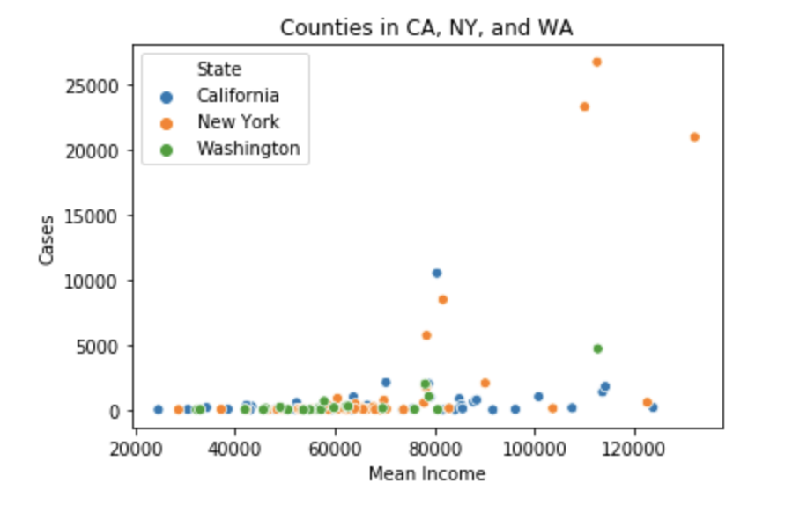
Comparing Counties in Specific States
Data Source: https://github.com/nytimes/covid-19-data https://www.kaggle.com/goldenoakresearch/us-household-income-stats-geo-locations

Slide 27
Conclusion
By 5/01/2020, cases and deaths exceed 800,000 and 40,000, respectively.
New York has the highest number of cases and deaths.
By looking at number of cases per capita, New York still has highest cases. However, New York is ranked 6 in number of deaths per number of cases. Michigan is number 1 in deaths per number of cases.
Based on the map, the most populated states appear to have the highest number of cases and deaths.
As expected, the more cases there are, the more deaths there may be.
There’s not a strong visual relationship between mean income and number of cases.

Slide 28
Bibliography
Github Repository: https://github.com/CSJohnLee/COVID19_Project
Datasets:
https://github.com/nytimes/covid-19-data
https://usafacts.org/visualizations/coronavirus-covid-19-spread-map/
https://covidtracking.com/data
https://www.kaggle.com/goldenoakresearch/us-household-income-stats-geo-locations
https://www.kaggle.com/lucasvictor/us-state-populations-2018#State%20Populations.csv

